Slide 1
Topic: Minimum Spanning Trees
EQ: How do I find a Minimum Spanning Tree from a network already drawn?

Slide 2
Topic: Minimum Spanning Tree EQ: How do I find one from a network already drawn?
Summary:

Slide 3
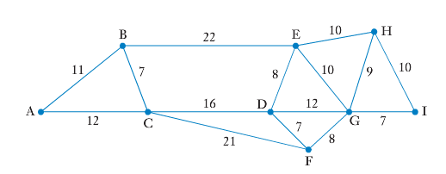
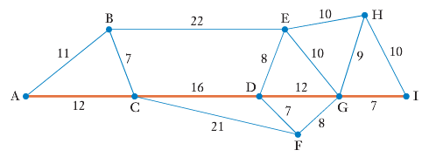
Topic: Minimum Spanning Tree EQ: How do I find one from a network already drawn?
The network on the left shows the roads that exist between 9 towns, A to I, with the numbers indicating the distances between them, in kms. The water authority would like to connect these towns to the water main, using the existing roads.
This is not the same as finding the shortest route from A to I, shown on the right, because it doesn’t connect up all of the towns.

Slide 4
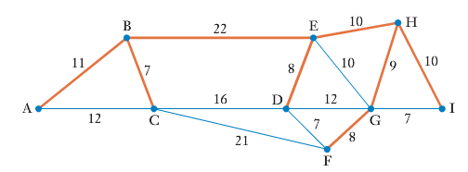
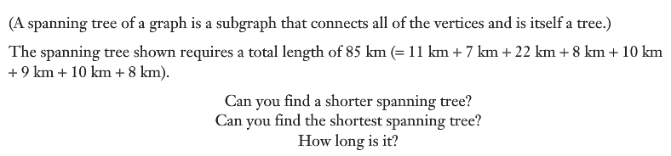
Topic: Minimum Spanning Tree EQ: How do I find one from a network already drawn?
Instead we need to find a system that includes all the farms but which has no unneccesary connections. What we need is a minimum spanning tree for this network.

Slide 5
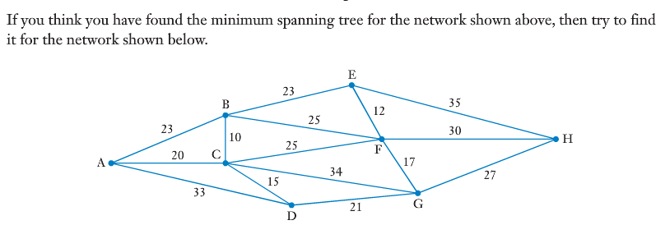
Topic: Minimum Spanning Tree EQ: How do I find one from a network already drawn?

Slide 6
Prim’s Algorithm
Thankfully, there are two set of steps we can follow so we don’t have to use trial and error. One is called Prim’s Algorithm. The steps are:
You can start at any vertex, but will usually be told a starting vertex
Add in the shortest edge connected to this
Now add in the shortest edge connected to either node as long as it connects to a new vertex
Continue until you have visited all vertices

Slide 7
Use Prim’s Algorithm to find a minimum spanning tree, starting from A.
B
7
E
18
G
12
21
9
11
A
15
13
D
19
F
8
10
C

Slide 8
Write down the lines in the order you choose them.
B
7
E
18
Our MST has a total weight of: 8 + 10+ 9 + 11 + 7 + 13 = 58 units
G
12
21
9
11
A
15
13
D
F
Why did we not choose AB instead of FG?
8
19
10
C
AC
CF
FE
EB
ED
FG

Slide 9
Topic: Trigonometry EQ: What are the key trigonometric ratios I need to know?
Sadler Chapter 5A
Summary:

Slide 10
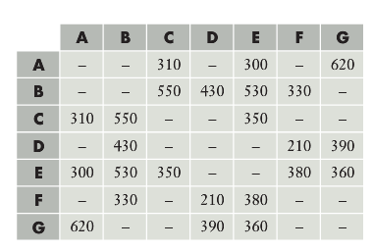
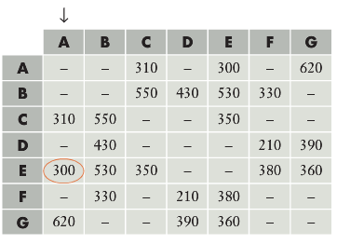
Topic: Minimum Spanning Tree EQ: How do I find one from a table?
Consider the table of distances on the right, which is the one from the last question.
While we can start from any vertex, we choose to start at A.
With A on line, we look down column A to see which is the shortest connection that can be made from A. in this case it is the 300km connection from town E.

Slide 11
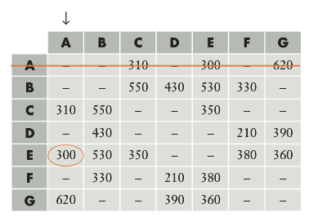
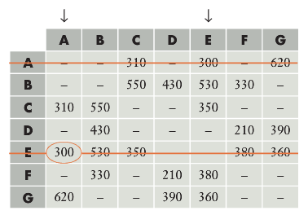
Topic: Minimum Spanning Tree EQ: How do I find one from a table?
Having chosen to look down the A column for a connection from A, we then rule a line through the A row. We do this to ensure that we do not later make an unnecessary connection back to A.
Having selected the 300km connection to vertex E, we now have both A and E on line and indicate this by the arrows at the tops of these columns. Again, we now rule a line through the E row.

Slide 12
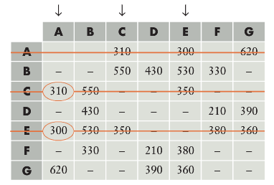
Topic: Minimum Spanning Tree EQ: How do I find one from a table?
We now look down the two on line columns, A and E, and choose the minimum connection that can be made form these two vertices.
This gives us the 310km road from A to C. This brings vertex C on line and we rule a line through

Slide 13
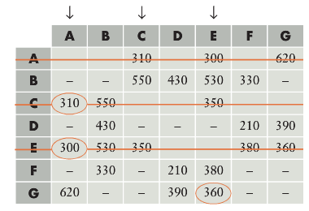
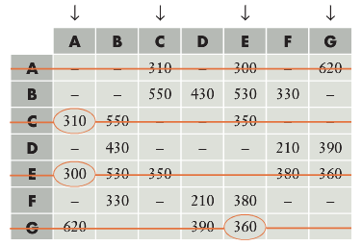
Topic: Minimum Spanning Tree EQ: How do I find one from a table?
We now look down our 3 online columns, A, C and E and choose the minimum connection that can be made from one of these three vertices.
This gives us the 360km road from E to G as our next conection. This brings row G on line and we rule a line through the G row

Slide 14
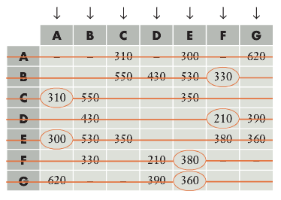
Topic: Minimum Spanning Tree EQ: How do I find one from a table?
We continue this process until all towns are online. The circled items in the table indicate the direct connections that together form the minimum spanning tree
From the completed table on the right we see that the roads AC, AE, EF, EG, FB and FD form the MST with a distance of 1890km

